Slide 1
Regression Analysis
Other Regression Methods
Nicoleta Serban, Ph.D.
Associate Professor
Stewart School of Industrial and Systems Engineering
Spatial Regression

Slide 2
About this lesson

Slide 3
Multiple Linear Regression
Data: {(x₁₁,.., x_{1p}),Y₁},….,{(x_{n1},.., x_{np} ),Y_{n}}
Model: Y_{i} = β₀ + β₁x_{i1} + β₂x_{i2} +…+ β_{p}x_{ip} + ε_{i}, i =1,…,n
What if uncorrelated errors assumption does not hold?
Degrees of freedom: not equal to the sample size
Higher variability or uncertainty than estimated thus less reliable statistical inference
Assumptions:
Linearity/Mean Zero Assumption: E(ε_{i}) = 0
Constant Variance Assumption: Var(ε_{i}) = σ²
Independence Assumption: {ε₁,…, ε_{n}} are independent random variables
Normality Assumption: ε_{i} ~ Normal

Slide 4
Example: Spatial Processes
Correlation in space:
Travel distance to a primary care provider evaluated at the community level
The number emergency department visit per member per-month
Locations of outbreak of a disease, for example, Zika
Functional Magentic Resonance Imaging (fMRI)
Trajectory of the bison in the landscape

Slide 5
Spatial Process: Characteristics
Trend: long-distance increase or decrease in the data over space
Smoothness: observations change slowly as the distance between their location increases
Heteroskedasticity: varying variance with space
Continuous vs. Discrete: at each location observe a numeric value versus a binary response versus a count response
Regular vs. irregular design: the spatial process can be observed within regular or irregular division of the space

Slide 6
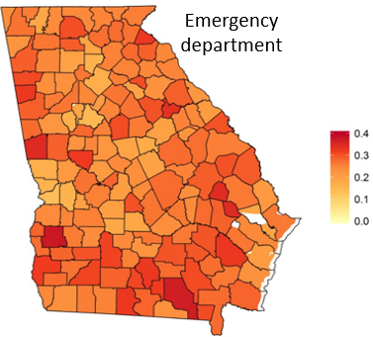
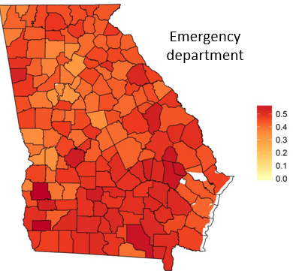
Example 1: ED Care Utilization
Percentage of Children with an ED visit
Percentage of Adults with an ED visit

Slide 7
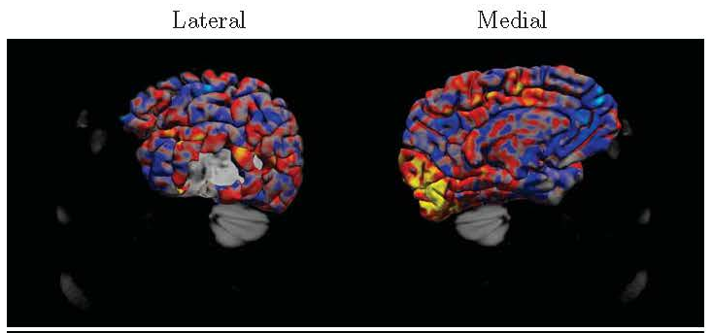
Example 2: fMRI

Slide 8
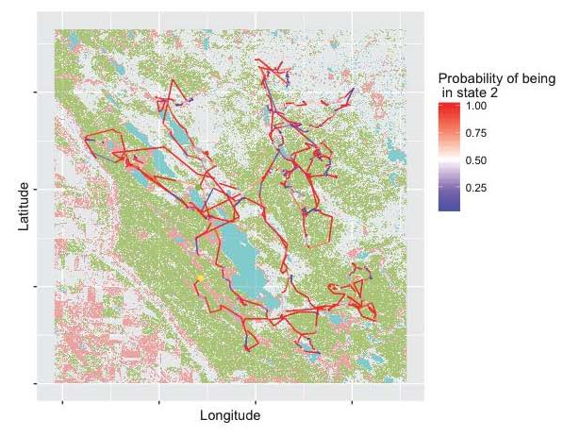
Example: Bison Trajectory

Slide 9
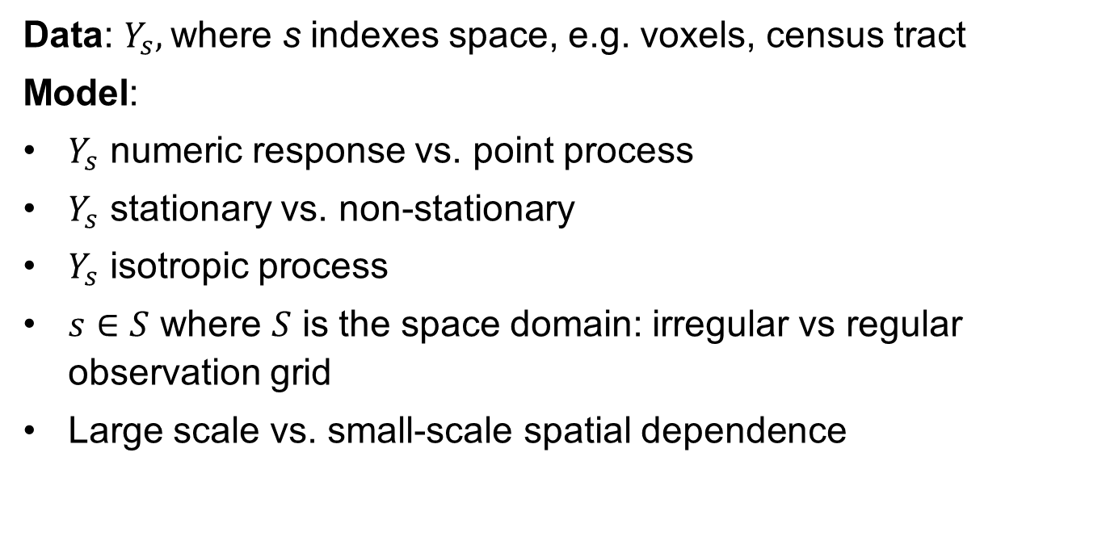
Spatial Analysis: Basics
Data: $Y_{s},$where s indexes space, e.g. voxels, census tract
Model:
$Y_{s}$ numeric response vs. point process
$Y_{s}$ stationary vs. non-stationary
$Y_{s}$ isotropic process
$s∈S$ where $S$ is the space domain: irregular vs regular observation grid
Large scale vs. small-scale spatial dependence
Notes:
Regular design or lattice data

Slide 10
Summary

